Slide 1
ANALYZING AND VIZ. OF EPIDEMIC DISEASES MAINLY CORONAVIRUS (COVID)
Submitted by:
Shaik mohammed obaid

Slide 2
What is coronavirus ?
Coronaviruses are a group of viruses that cause disease in mammals and birds
In human, coronaviruses cause respiratory tract infections that are typically mild, such as common cold .
Coronaviruses are transmitted between animals and humans.

Slide 3
OUTBREAK OF CORONAVIRUS
The novel coronavirus(nCOV) is said to have originated from a seafood market in China’s Wuhan where wildlife was reportedly sold illegally.
It is not known yet which animals are responsible though many reports suggests it to be snakes.

Slide 4
Objective
To Analyse the number of people affected with Coronavirus through Confirmed, Recovered or Deaths.
To Visualize data for the same.

Slide 5
Libraries used
Pandas
Numpy
Matplotlib
Seaborn
Folium

Slide 6
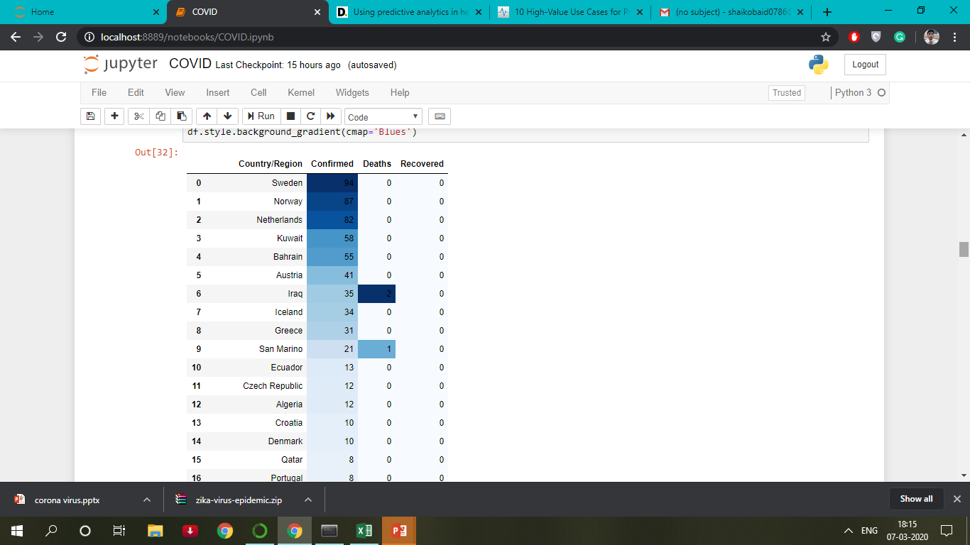
ANALYSIS

Slide 7
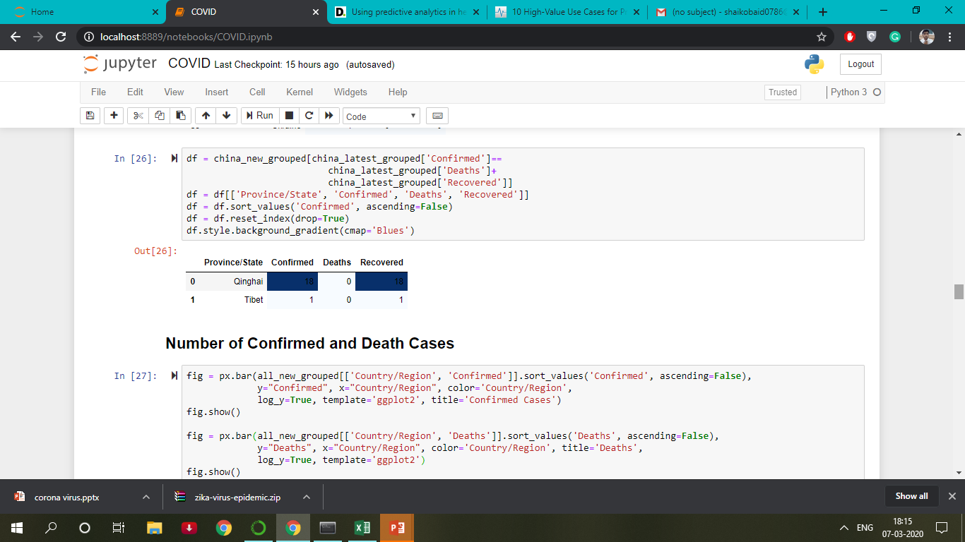
Analysis

Slide 8
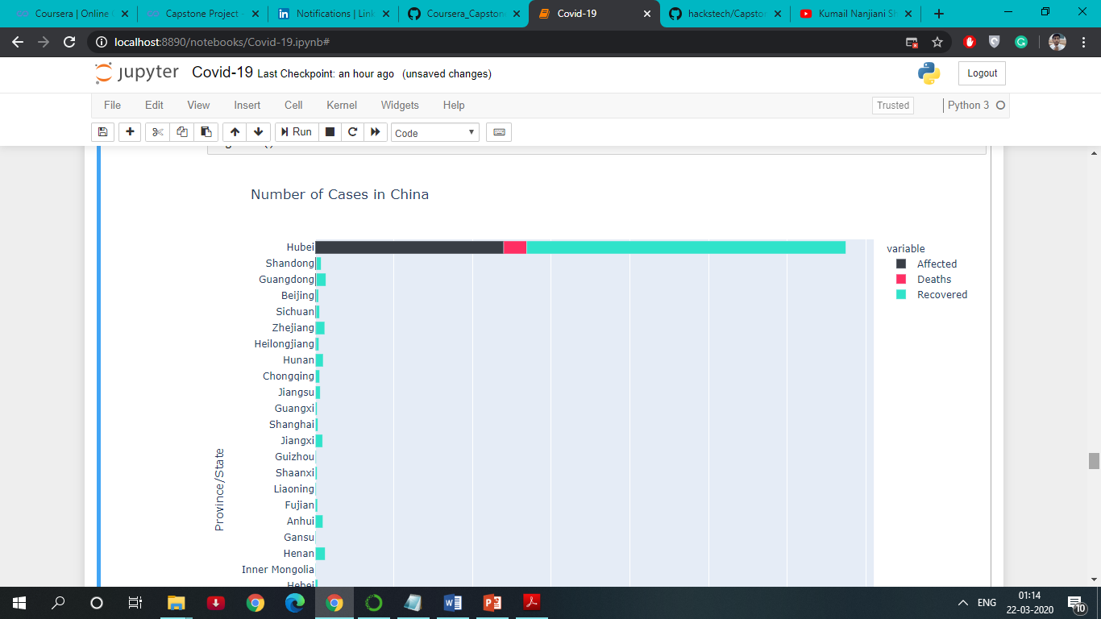
NO. of cases in china

Slide 9
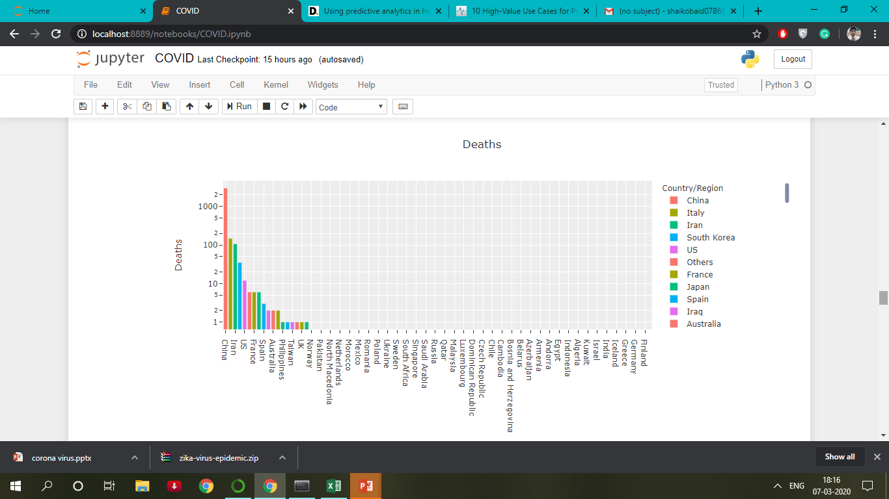
VISUALIZATION of the no.of death cases and deaths

Slide 10
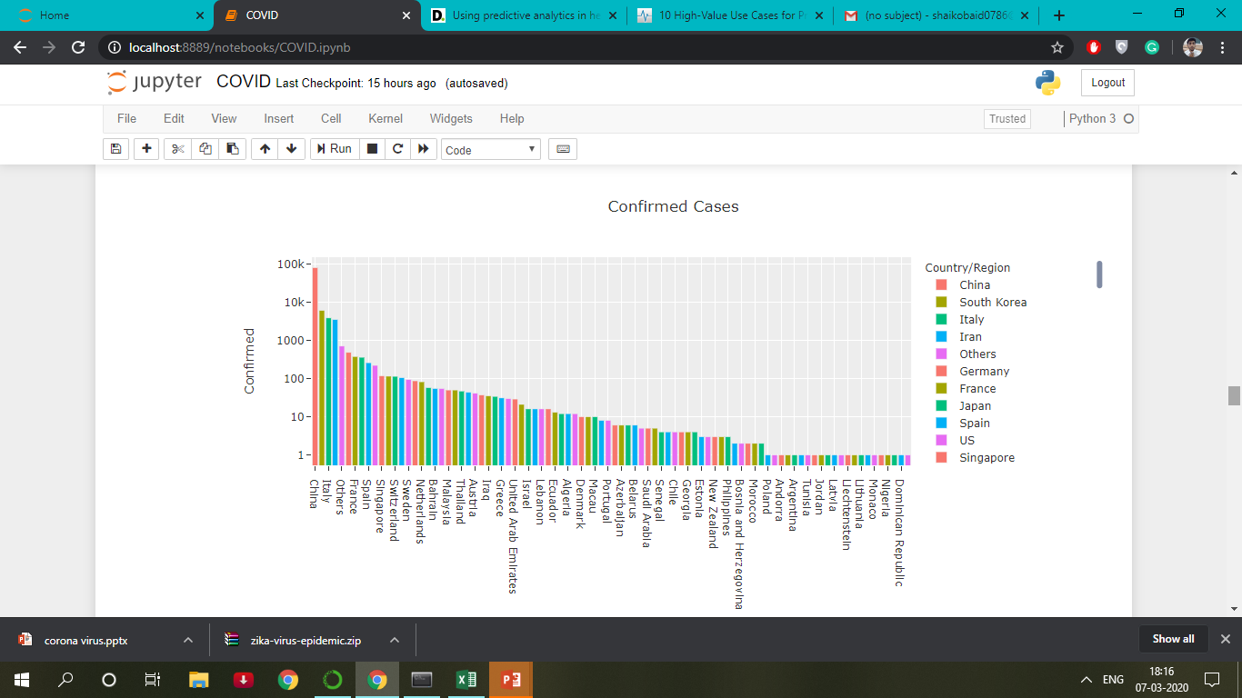

Slide 11
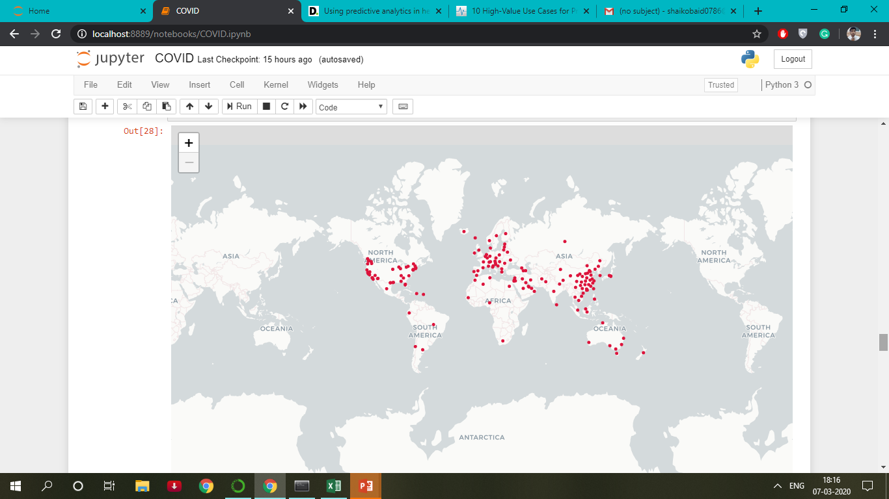
Confirmed cases Across the globe

Slide 12
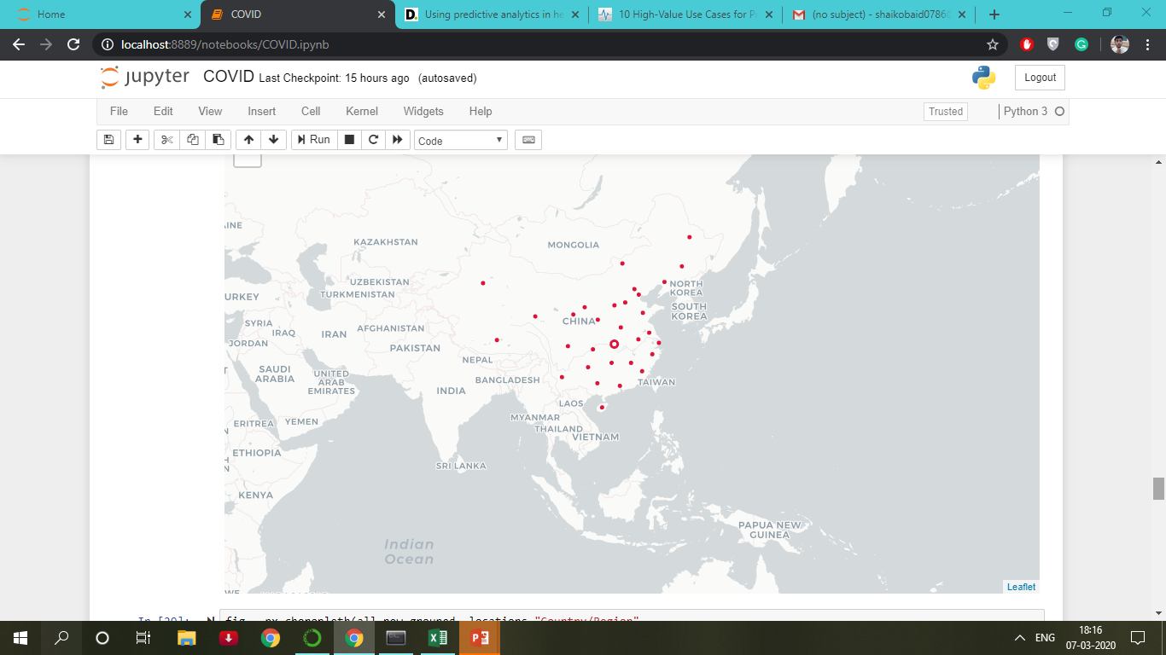
Confirmed cases Across china

Slide 13
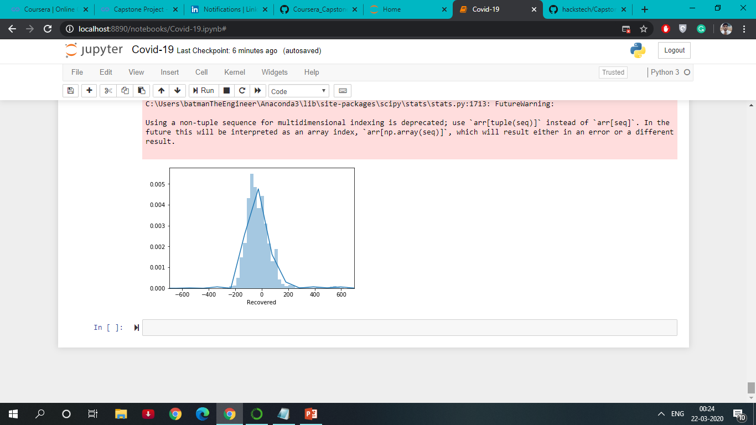
Used logistic regression to predict the no. of recovered cases.

Slide 14
BUSINESS ASPECTS
Data can be served to many of the medical companies to analyse and develop medicines to treat the coronavirus, hence the prototype will be profitable.
Developing Precision Medicine And New Therapies
Improving efficiencies for operational management of health care business operations.
Accuracy of diagnosis and treatment in personal medicine.
Increased insights to enhance cohort treatment.

Slide 15


